Slide 1

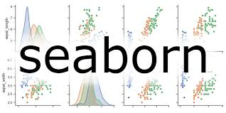

EXPLORATORY DATA ANALYSIS USING MATPLOTLIB AND SEABORN

Slide 2


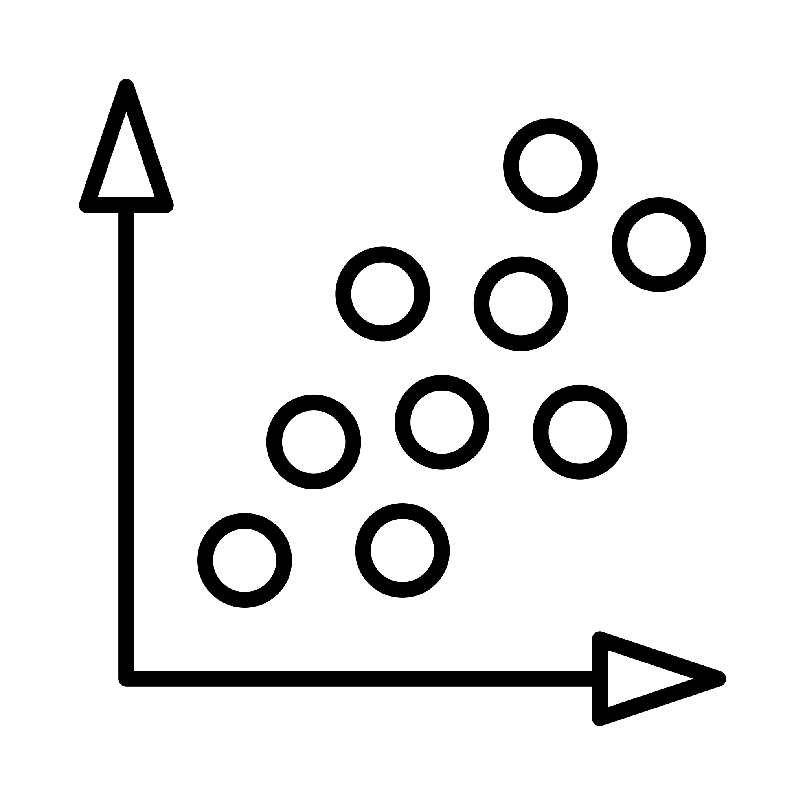
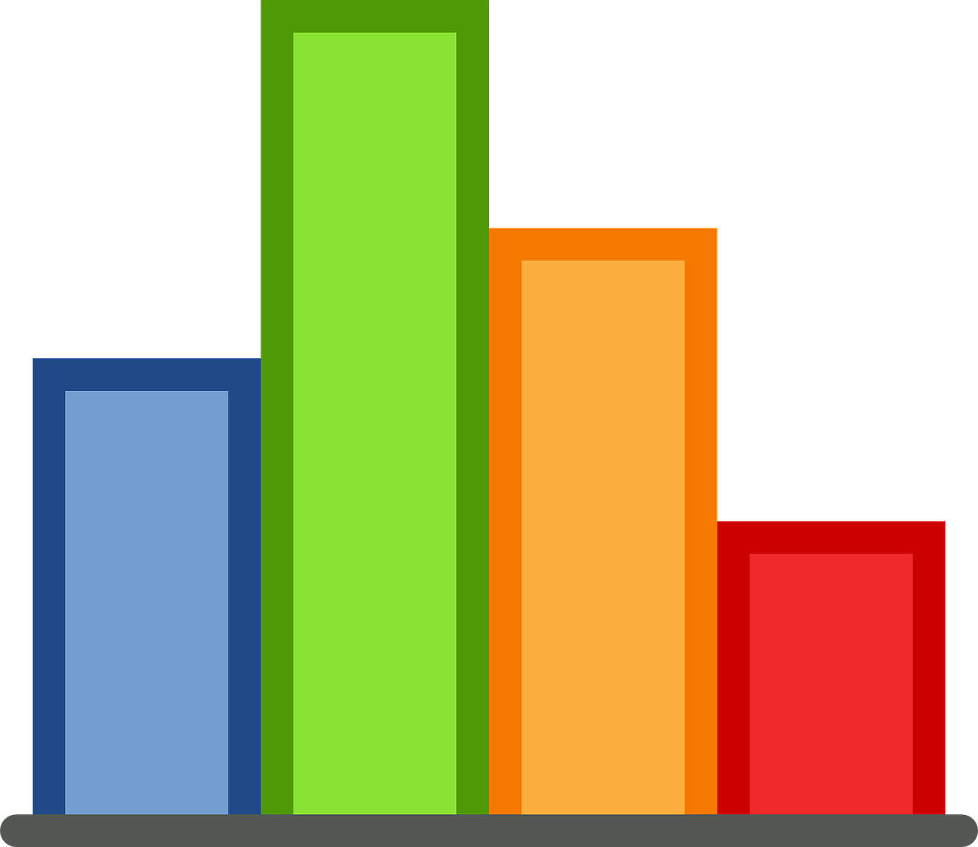

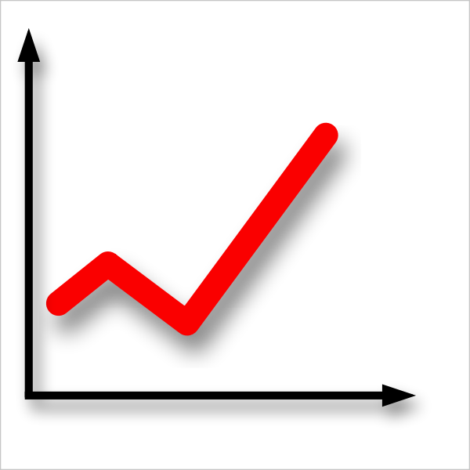
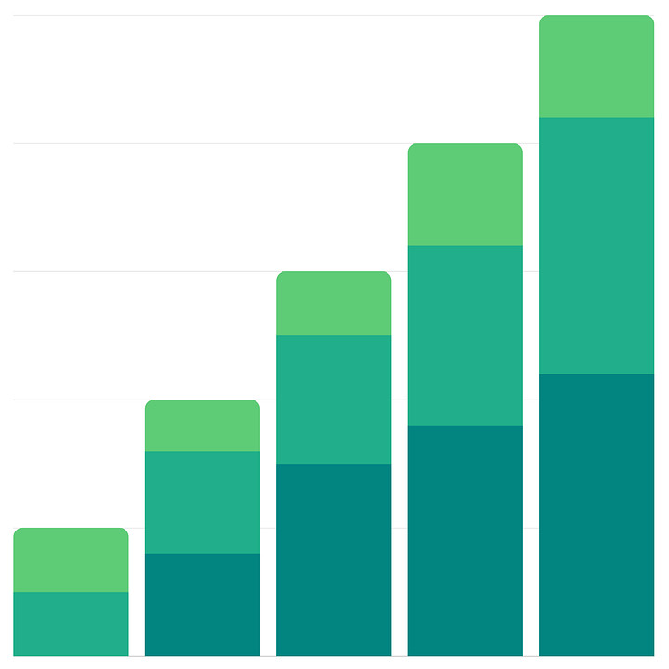
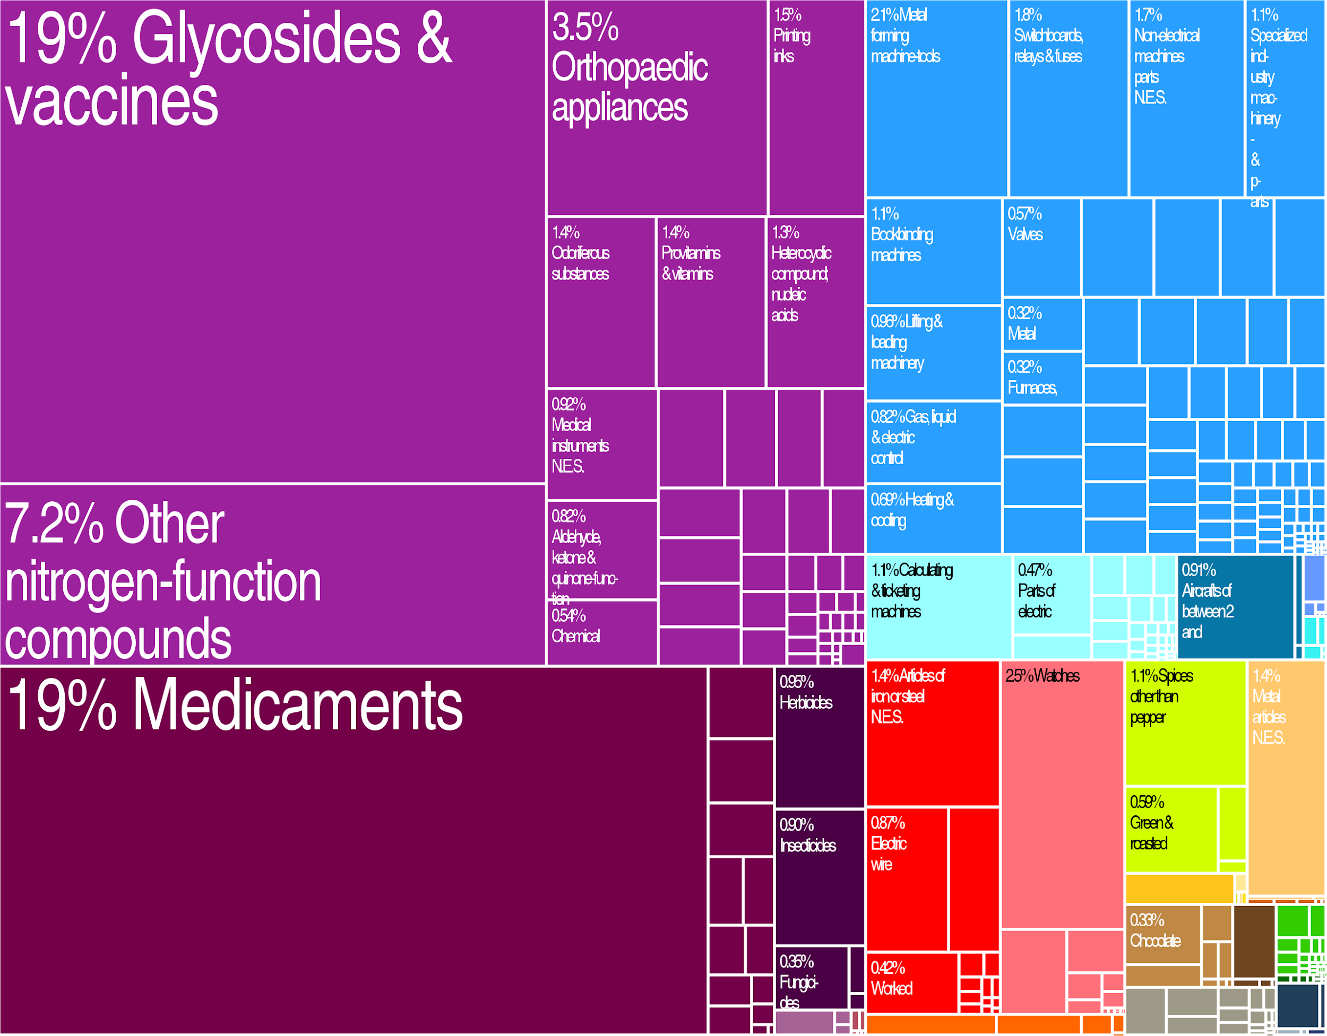
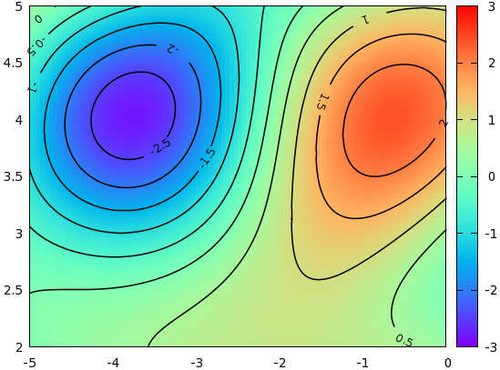
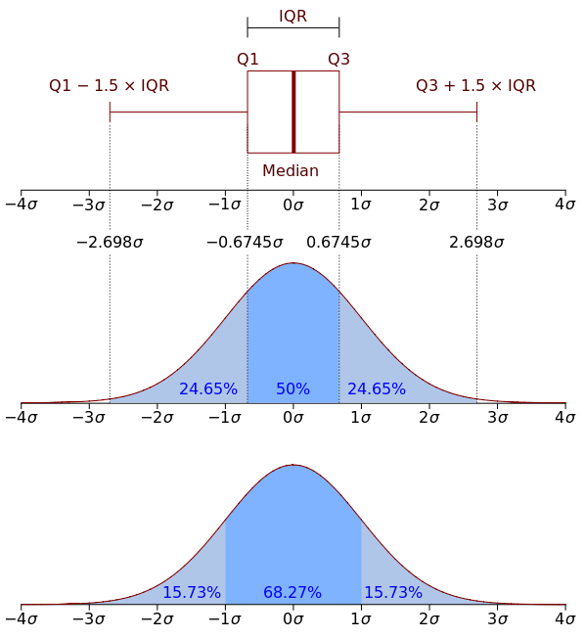
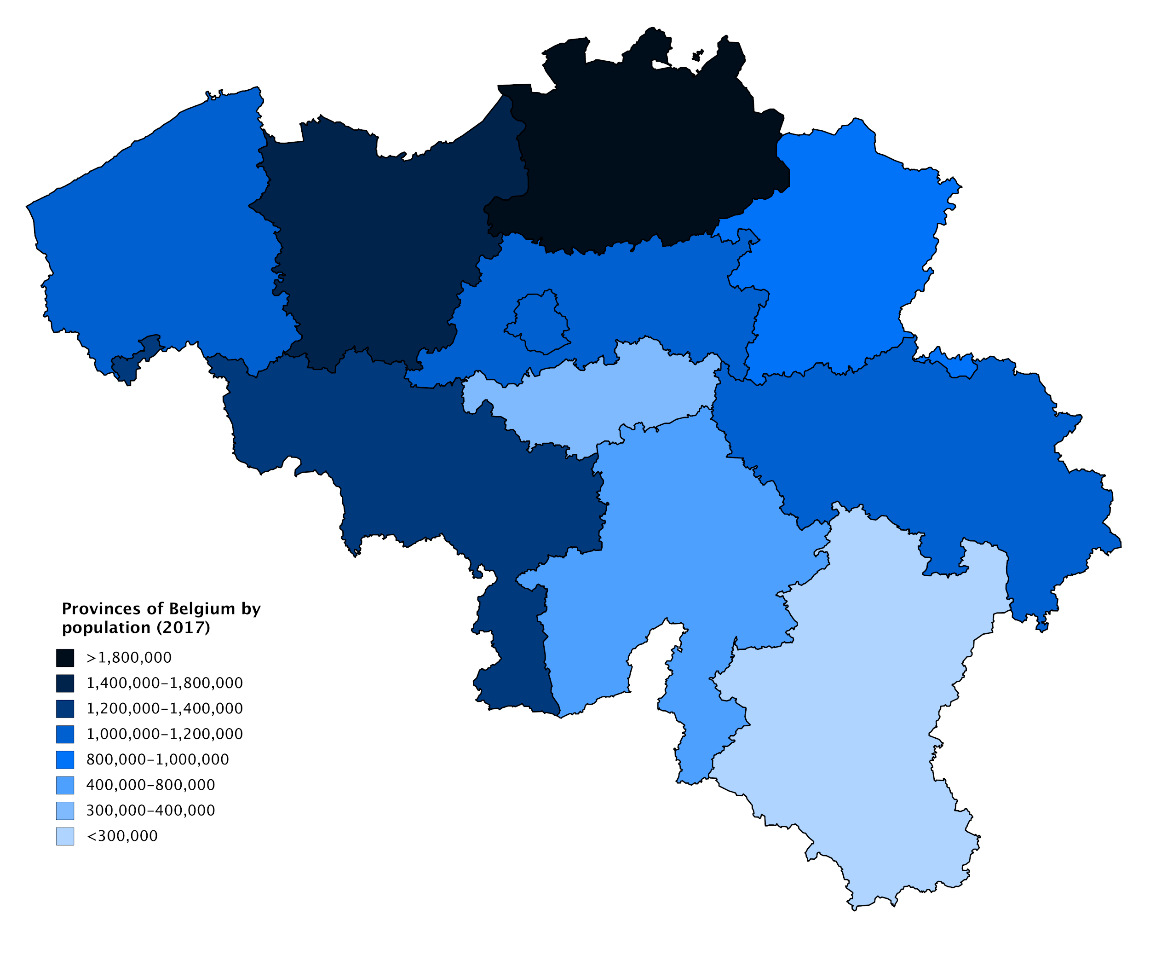
SELECTING EFFECTIVE VISUALS
There are many elements available to communicate data:
Text
Scatter
Barplot
Table
Lineplot
Stacked Barplot
Tree map
Contour plot
Distribution
Choropleth

Slide 3
WHEN TO USE TEXT
When you need to communicate one or two values
Text

Slide 4
WHEN TO USE SCATTER PLOTS
When you to explore relationships between two numerical columns.
Scatter

Slide 5
WHEN TO USE BAR PLOTS, TREE MAPS OR DISTRIBUTION PLOTS
To show frequencies or proportions
Frequencies for discrete
values
Distributions for continuous values
Distribution
Barplot
Proportions within a group
Stacked Barplot
Tree map

Slide 6
WHEN TO USE TABLES
AVOID THEM or color the background to focus the attention of audience to an specific value.
Use a color gradient with two colors
Avoid rainbow as it overloads the “cognitive load” of the audience
Table

Slide 7
WHEN TO USE LINE PLOTS
When to explore how a column changes over time (Days, months, years,...)
Lineplot

Slide 8
WHEN TO USE CHOROPLETH MAPS
When you want to explore geographical locations.
Choropleth

Slide 9
EXPLORATORY ANALYSIS WITH MATPLOTLIB AND SEABORN
Creation of almost any kind of plot:
Histograms
Bar charts
Scatter plots
Lines
Pies
surface
Seaborn is based on matplotlib.
Load them as:
import matplotlib.pyplot as plt
import seaborn as sns
%matplotlib inline
https://matplotlib.org/
https://seaborn.pydata.org/
00

Slide 10
MATPLOTLIB: HOW TO CREATE A PLOT
There are many ways to create plots in matplotlib.
We need to first, consider ask ourselves what we want to create:
Single plot
Several overlapped plots
Several non-overlapped plots
The syntax depends mainly on the answer to the previous question

Slide 11
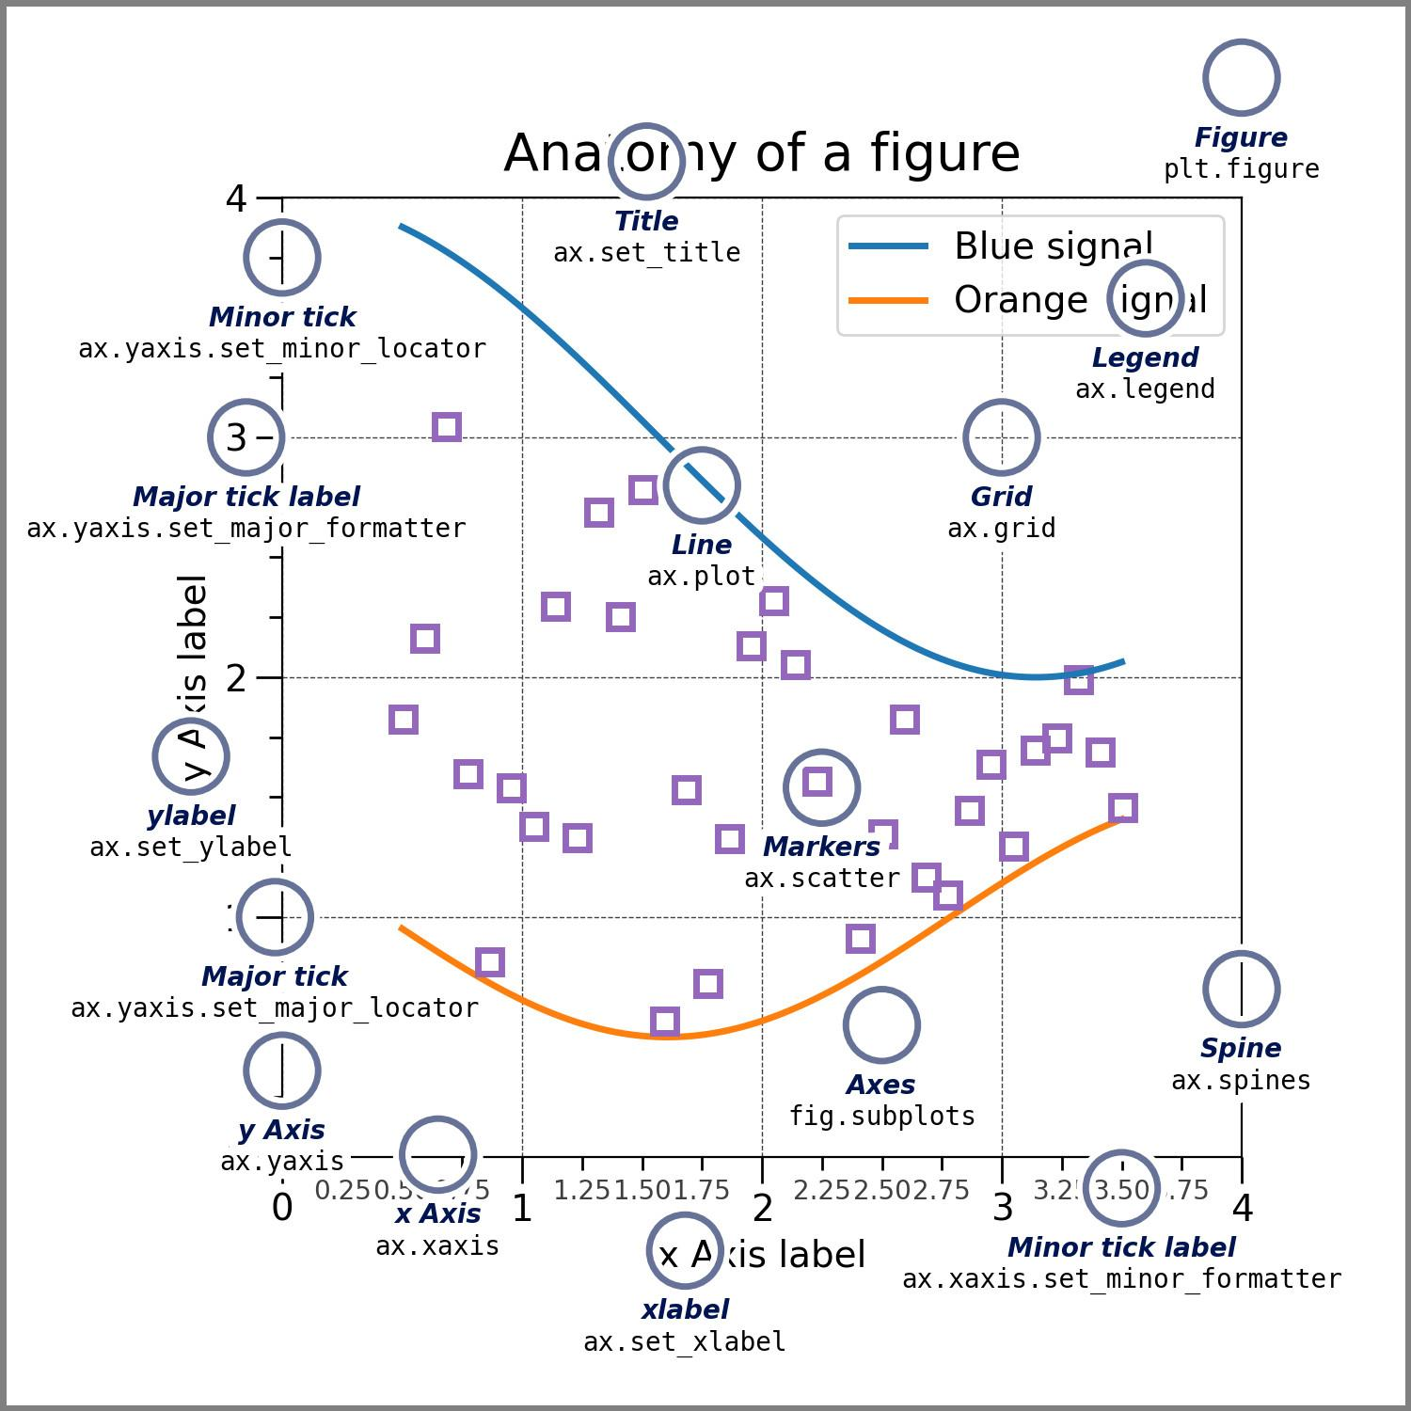
STRUCTURE OF A PLOT IN MATPLOTLIB
A plot in matplotlib is made of multiple elements:
Figure
Axes
Title
Each element is controlled by a different function.
Each kind of plot has a different function.
Source: https://matplotlib.org/stable/gallery/showcase/anatomy.html

Slide 12
MATPLOTLIB FUNCTIONS FOR SINGLE PLOTS
plt.scatter(x, y, sc=list_of_sizes, c=list_of_colors)
plt.show()
Scatter
plt.bar(x, y, width=1, edgecolor=color, linewidth=0.7)
plt.show()
Barplot

Slide 13
MATPLOTLIB FUNCTIONS FOR SINGLE PLOTS
plt.scatter(x, y, sc=list_of_sizes, c=list_of_colors)
plt.show()
Scatter
plt.bar(x, y, width=1, edgecolor=color, linewidth=0.7)
plt.show()
plt.hist(x, bins=8, linewidth=0.7, edgecolor=color)
plt.show()
Barplot

Slide 14
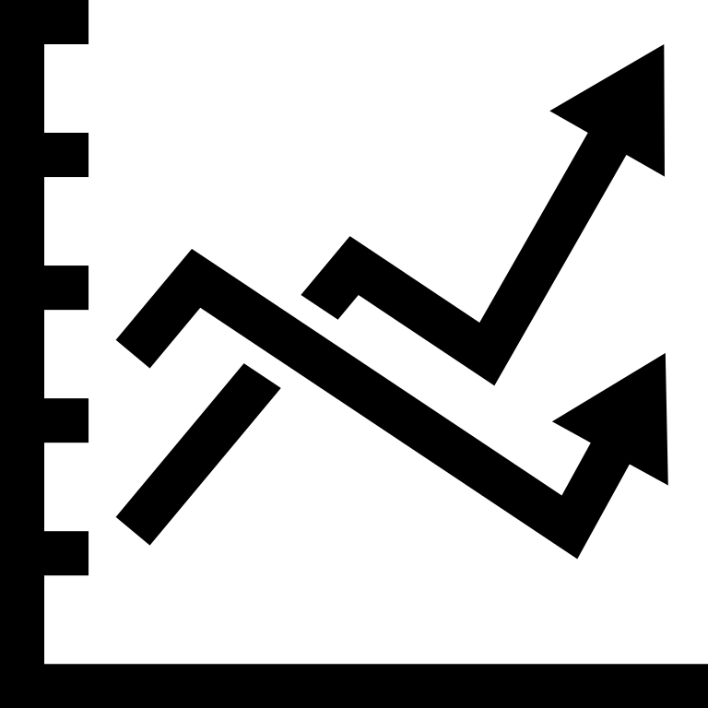
MULTIPLE PLOTS IN A SINGLE PLOT
When we want to overlap multiple elements, we need to use a different syntax:
fig, ax = plt.subplots()
ax.plotfunction() (scatter(), bar(),...etc)

Slide 15
MULTIPLE PLOTS TOGETHER
When we want to create several plots together we need first to think in how many rows and columns we want to arrange the plots in the canvas.
The syntax is the same as before, but now the “ax” variable becomes a “numpy” array.
Every plot should be added to the axis using the corresponding index: ie:
ax[0].scatter()
ax[1].plot()
ax[2].hist()

Slide 16
MULTIPLOT EXAMPLE
To create a canvas which contains several plots, we can use:
fig, ax = plt.subplots(2,3, figsize=(10,3), dpi=200)
ax[0,0].plot()
ax[0,1].hist()
ax[1,0].plot()
ax[1,1].hist()
ax[1,2].boxplot()
plt.show()
axes[0,0]
axes[0,1]
axes[0,2]
axes[1,0]
axes[1,1]]
axes[1,2]

Slide 17
SEABORN PLOTS
Seaborn is a library based on matplotlib. Therefore, Seaborn plots can be used together with matplotlib functions.
Seaborn plots have a nicer look and feel than matplotlib ones.
Seaborn has their own different functions for each type of plot:
sns.countplot()
sns.lineplot()
sns.displot()
…
We can control in which axis we want to add the Seaborn plot with the internal function option: “ax = …”:
sns.countplot( ax = ax[1])

Slide 18
SEABORN PLOTS
The typical syntax of a Seaborn function is:
sns.function(data = df, x = “col_name1”, y=”col_name2”, hue=”col_name3”, ax = ax[i])
The available options in each function depend on the function. However, some options are common to all of them:
data -> the name of the dataframe
x -> the column to be displayed on the “x” axis
y -> the column to be displayed on the “y” axis
ax -> in which axis we want to add the plot.

Slide 19
CUSTOMIZING AXES AND TITLES
To control the axes labels, we can use:
axes[0,0].set_ylabel()
axes[0,0].set_xlabel()
….
Finally, to set the plot title, we can use:
axes[0,1].set_title()

Slide 20
SAVING YOUR PLOTS INTO FILES
To save a figure on your hard drive:
plt.savefig(“file_name.png”, format=)
The file will be saved in the same folder where we opened the Jupyter notebook unless that in the file name, we use absolute path or relative path.(ie: plt.savefig(“../images/my_figure.png”) )
For more details, checkout the official documentation:
Saving figures

